Slide 1

Statistical Modeling with Python
Bike Rental Stations, Yelp and Foursquare Points of Interest
Julie Leung

Slide 2
Agenda
Process Flow
Data Transformation
Statistical Model Results
Next Steps

Slide 3
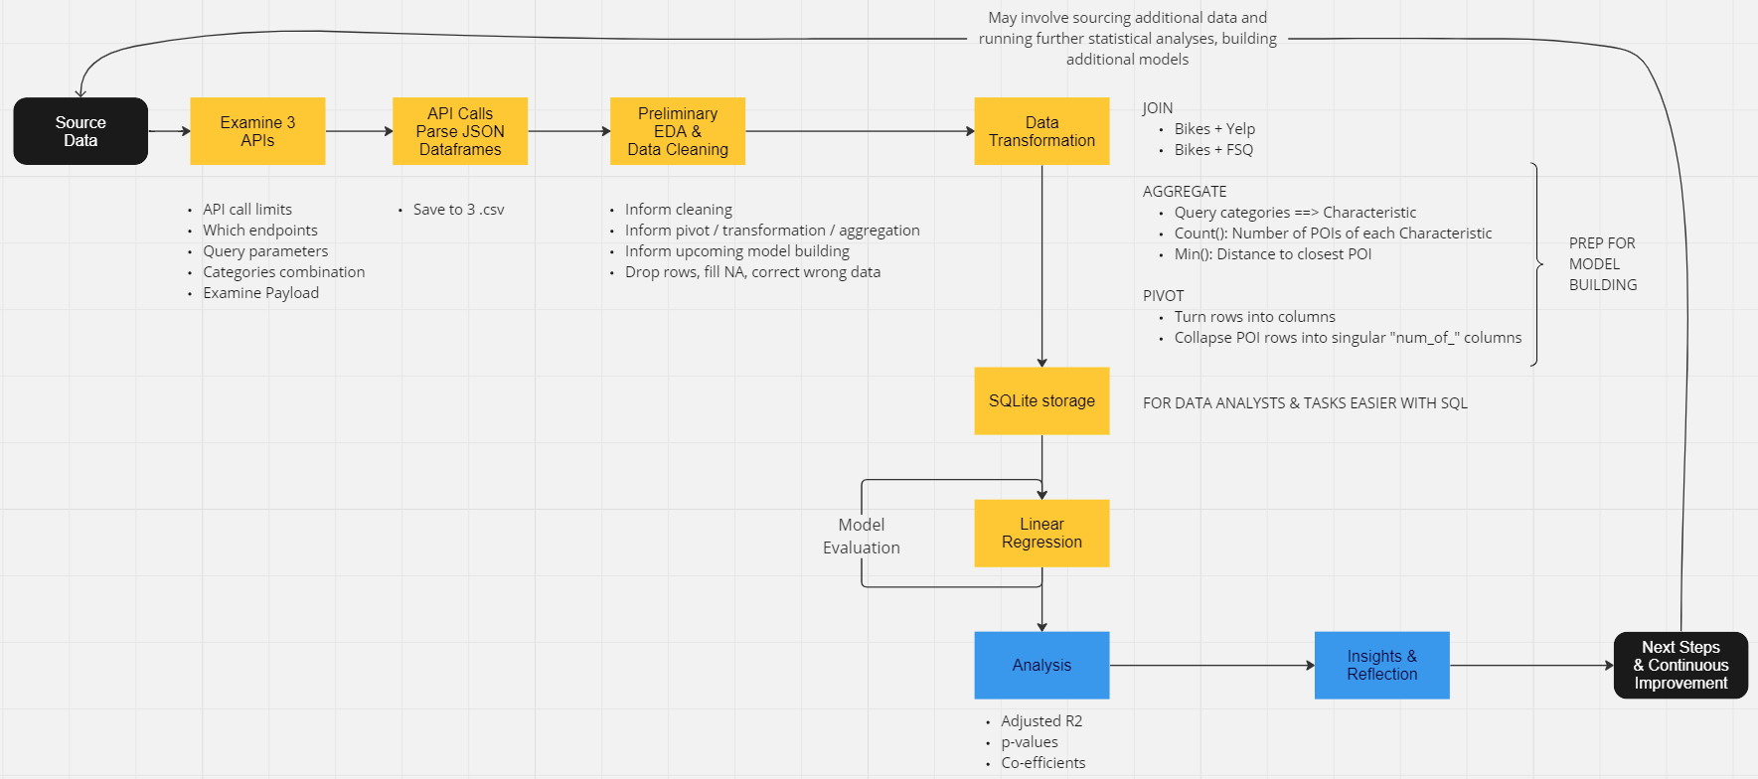
Process Flow

Slide 4
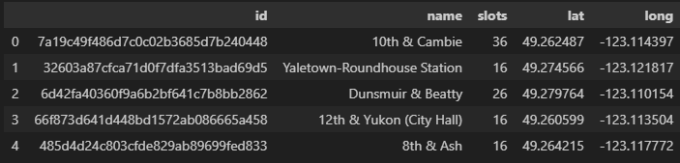
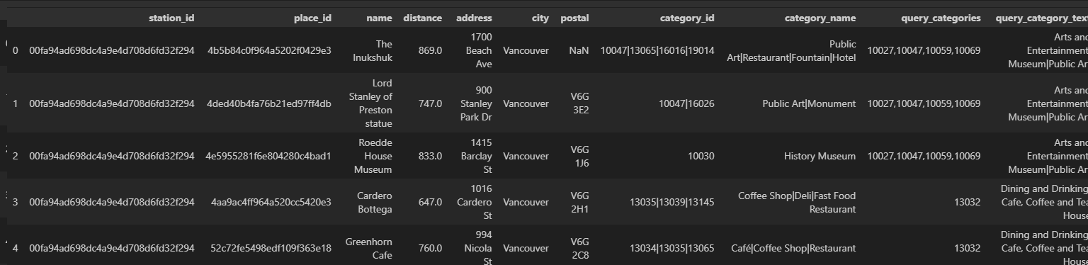
Data Transformation: JOIN
Citybikes API: bikes_df
pd.merge
FSQ API: fsq_df

Slide 5
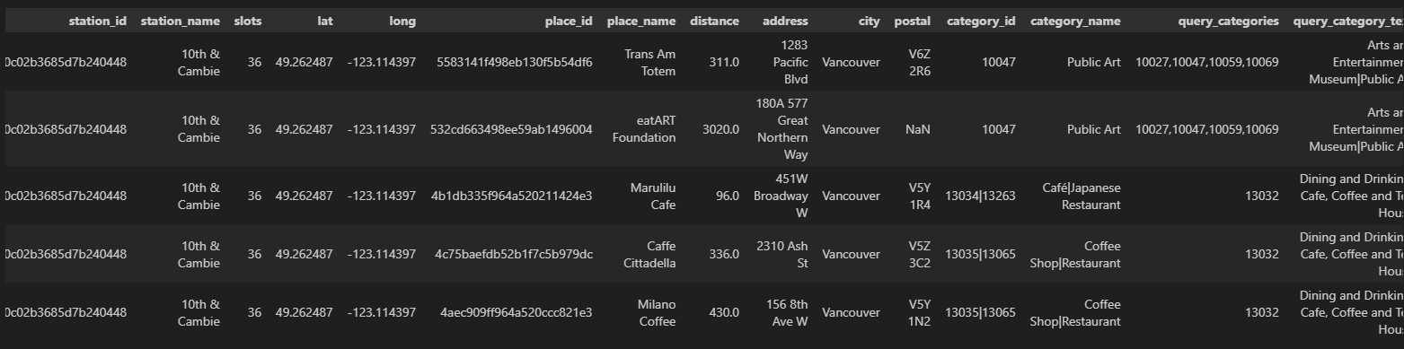
Data Transformation: JOIN
came from: bikes_df:
came from: fsq_df
fsq_poi_bikes_df:

Slide 6
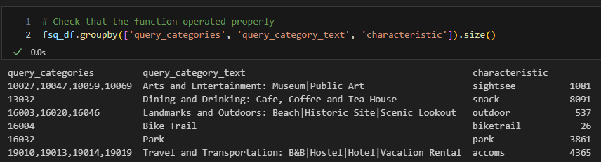
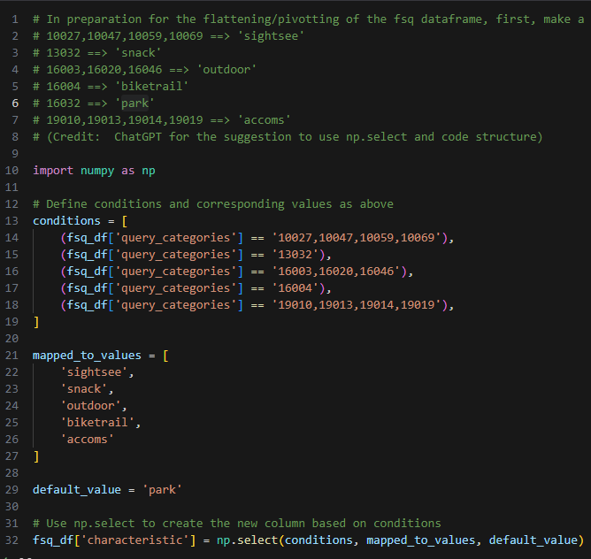
Data Transformation
AGGREGATE
(characteristics)

Slide 7
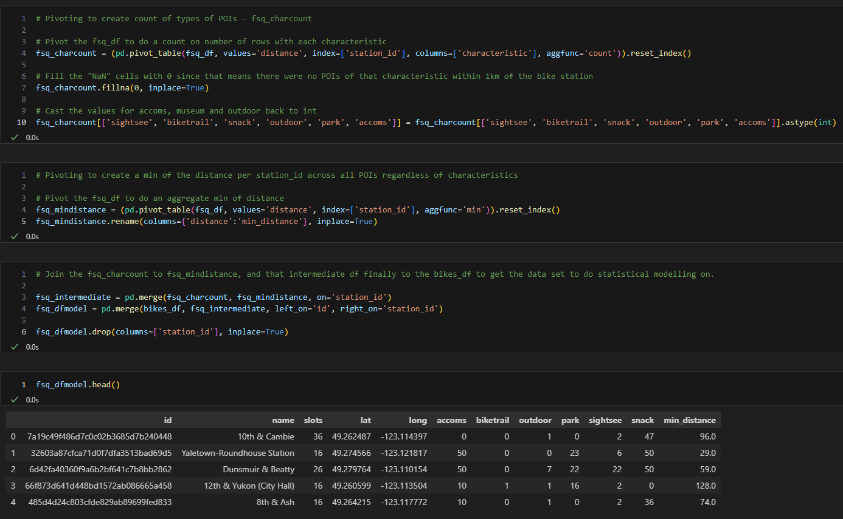
Agg &
Pivot

Slide 8
Process Flow

Slide 9
Statistical Model Evaluation
Forward Selection
Multivariate OLS (ordinary least squares)
y = # slots at bike rental station
Candidates for x (all within 1 km radius) | Adjusted R Squared
# accoms | 0.003
# biketrail | 0.010
# outdoor | 0.081
# park | -0.003
# sightsee | 0.011
# snack | 0.009
min_distance to nearest POI | 0.012
Best Last Adj R2: 0.081

Slide 10
Forward Selection: Step 2
Step 2: “# outdoor” and:
Candidates for additional x (all within 1 km radius) | Adjusted R Squared
# accoms | 0.081
# biketrail | 0.080
# park | 0.088
# sightsee | 0.077
# snack | 0.100
min_distance to nearest POI | 0.083
Best Last Adj R2: 0.100

Slide 11
Forward Selection: Step 3
Step 2: “# outdoor” and “# snack” and:
Candidates for additional x (all within 1 km radius) | Adjusted R Squared
# accoms | 0.096
# biketrail | 0.099
# park | 0.100
# sightsee | 0.102
min_distance to nearest POI | 0.108
Not much better – so stop adding variables!
Best Last Adj R2: 0.100

Slide 12
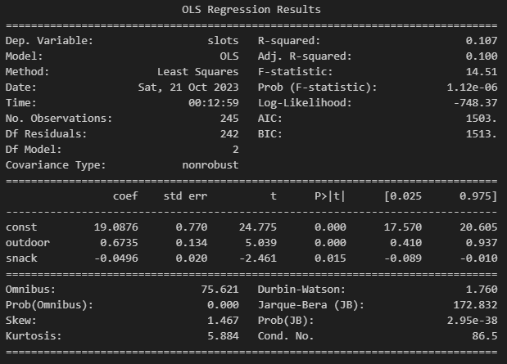

Linear Regression Results
Adj. R² = 0.100 means:
Variation in Y not much explained by variation in X
Model not a good fit to data
Other factors not included in model contribute to variation in Y
p-values for “# outdoor”, “# snack”, y-intercept < 0.05 ➔ co-efficients not 0
EQUATION:

Slide 13
Next Steps
Model Build on Yelp data, especially including “review count” and “avg. rating”
More data from FSQ & Yelp without API limits causing categorization squeeze and “maxxing out”
# bikes for rent at each station is an optimization problem:
gather utilization data (free slots / total slots) throughout day & year
differentiate between operators
Gather additional data (e.g. population density around each station)

Slide 14
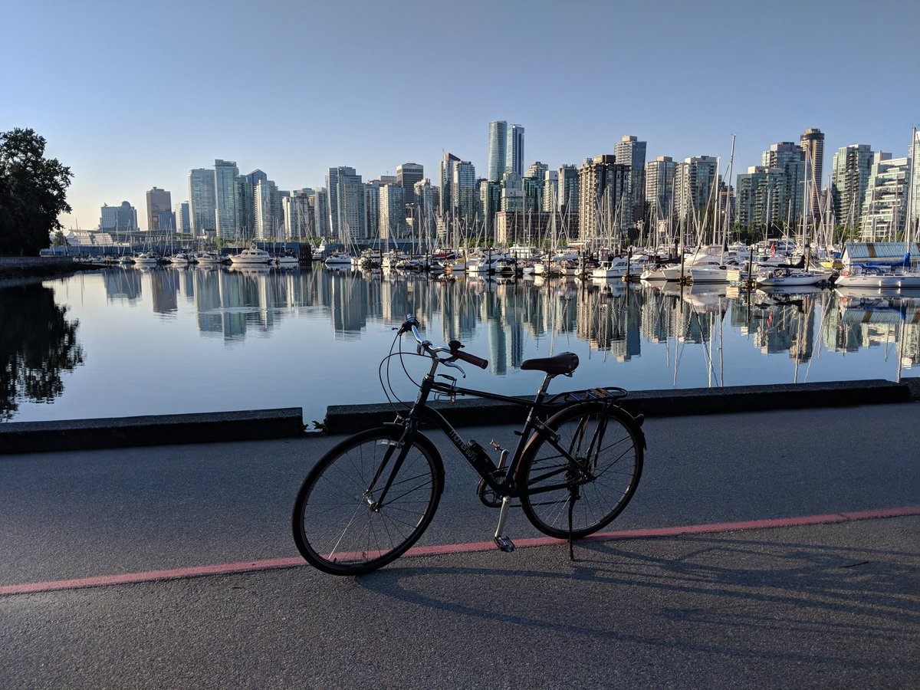
Questions?
Image Credit: StanleyParkVan.com https://stanleyparkvan.com/stanley-park-van-activity-bicycling.html

